Slide 1
BIG THUMBS TOUGH

Slide 2

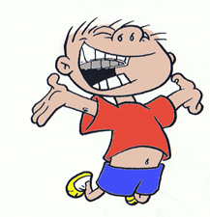
Big thumbs tough and big thumbs strong
Other fingers wave along
Little fingers just like me
Tiny but IMPORTANT!

Slide 3
BANANAMAN

Slide 4
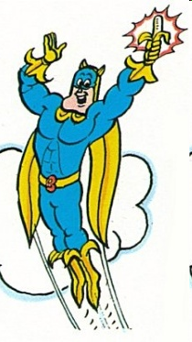
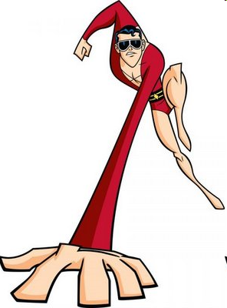
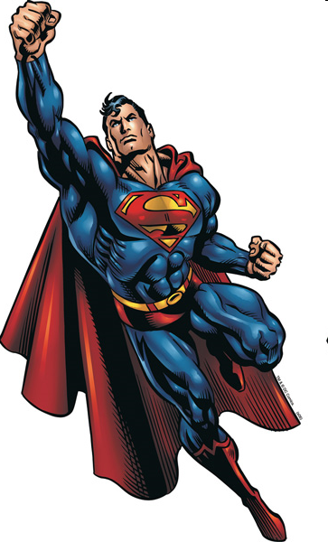
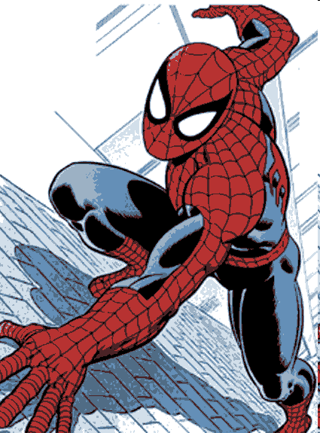
I may never bend like Bananaman
Climb like Spiderman
Stretch like Plastic Man
I may never fly like Superman
But I am special to God
I am special to God (Yes!)
I am special to God (Yes!)

Slide 5
BIGGER THAN BIG

Slide 6

God You made our big blue sky
You made the oceans deep and wide
God You made the trees so tall
And Your love is bigger than it all

Slide 7


God You’re bigger than big
Stronger than strong
You are mightier than mighty
And LOUDER than this song

Slide 8



Your love for me reaches farther than far
I can’t imagine just how big You are
Just how big You are

Slide 9
God You made our big blue sky
You made the oceans deep and wide
God You made the trees so tall
And Your love is bigger than it all

Slide 10
God You’re bigger than big
Stronger than strong
You are mightier than mighty
And LOUDER than this song

Slide 11
Your love for me reaches farther than far
I can’t imagine just how big You are
Just how big You are

Slide 12
God Your bigger than big
Stronger than strong
You are mightier than mighty
And LOUDER than this song

Slide 13
Your love for me reaches farther than far
I can’t imagine just how big You are
Just how big You are

Slide 14
I can’t imagine just how big You are
Just how big You are

Slide 15
THE LIONS ROAR

Slide 16
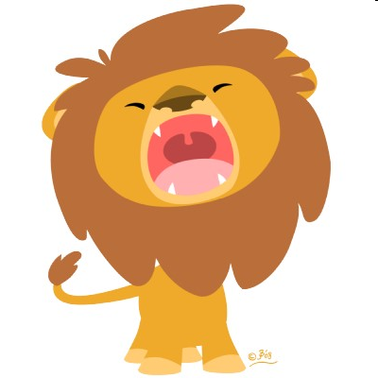
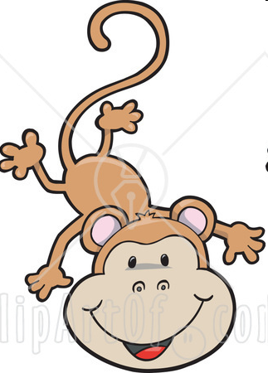

The lions roar (roar)
And the monkey’s say ‘oo’ (oo, oo, oo)
The parrots squawk (awk, awk)
But they can’t say I love you like I do

Slide 17
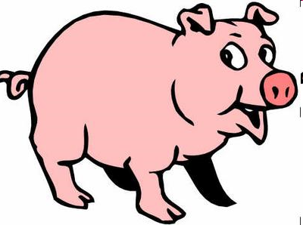
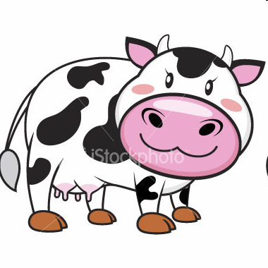
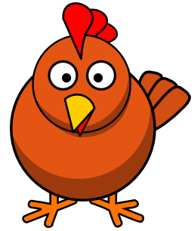
The pigs go oink (oink, oink, oink)
And the cows say moo (moo)
The chickens cluck (cluck, cluck, cluck)
But they can’t say I love you like I do

Slide 18

So I sing I love you (I love you)
Shout I love you (I love you)
And I whisper I love you (I love you)
Everyday (x2)

Slide 19
The lions roar (roar)
And the monkey’s say ‘oo’ (oo, oo, oo)
The parrots squawk (awk, awk)
But they can’t say I love you like I do

Slide 20
The pigs go oink (oink, oink, oink)
And the cows say moo (moo)
The chickens cluck (cluck, cluck, cluck)
But they can’t say I love you like I do

Slide 21
So I sing I love you (I love you)
Shout I love you (I love you)
And I whisper I love you (I love you)
Everyday (x2)

Slide 22
AS I SIT QUIETLY

Slide 23
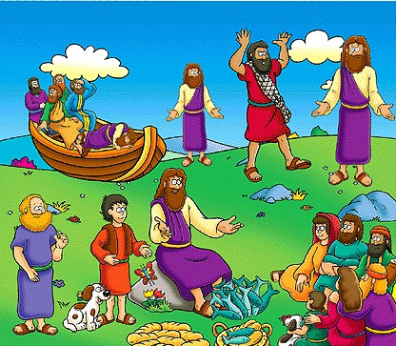
As I sit quietly, ever so quietly
Arms by my side, ears open wide;
Help me to listen, as people now teach me
More of the stories of Jesus

Slide 24
NOTHING’S TOO BIG

Slide 25




Nothing’s too big, big, big for His power
Nothing’s too little, little for His care
Nothing’s too big, big, big for His power
Nothing’s too idly, widdly for His care

Slide 26
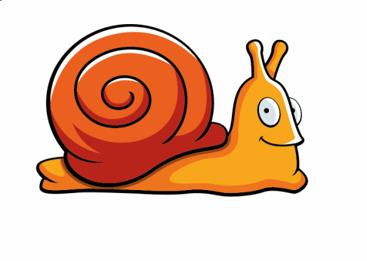

Nothing’s too big, big, big for His power
Nothing’s too incy, wincy for His care
Nothing’s too big, big, big for His power
Nothing’s too teeny, weeny for His care

Slide 27



He is God of the big,
God of the little
God of the stuff somewhere in the middle
The King of moving mountains
Loves you more than you will ever know

Slide 28
Nothing’s too big, big, big for His power
Nothing’s too little, little for His care
Nothing’s too big, big, big for His power
Nothing’s too idly, widdly for His care

Slide 29
Nothing’s too big, big, big for His power
Nothing’s too incy, wincy for His care
Nothing’s too big, big, big for His power
Nothing’s too teeny, weeny for His care

Slide 30

He is God of the big,
God of the little
God of the stuff somewhere in the middle
The King of moving mountains
Loves you more than you will ever know

Slide 31

Nothing’s too big, nothing’s too small
Nothing’s too much He cares for it all

Slide 32
HAPPY BIRTHDAY

Slide 33


Happy Birthday to you
God’s blessing on you
Happy Birthday dear ……..
God bless and keep you

Slide 34
I CAN WRIGGLE

Slide 35
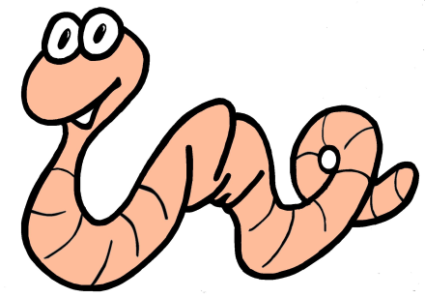


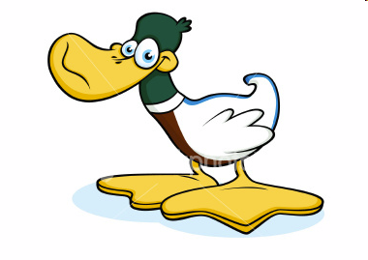
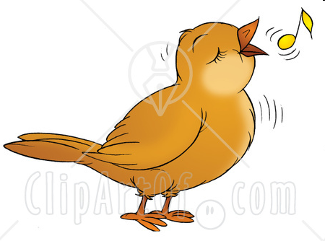
I can wriggle like a worm
Jump like a flea
Growl like a tiger
And buzz like a bee
I can waddle like a duck
And sing like a bird
I am wonderfully made
Wonderfully made
And I thank You God

Slide 36
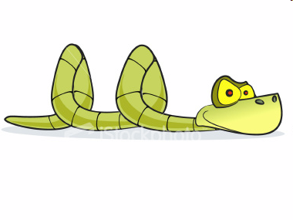

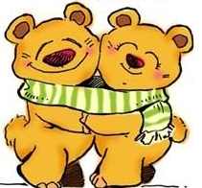

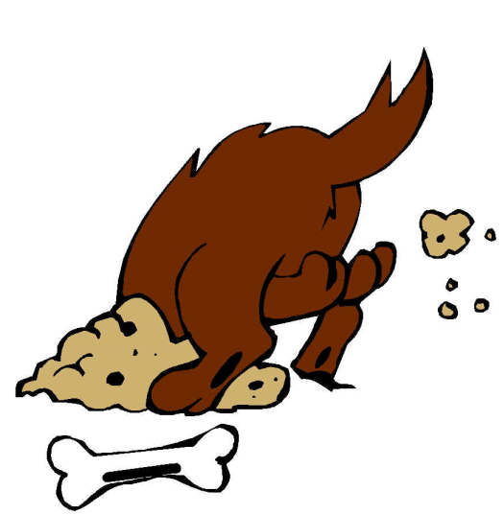
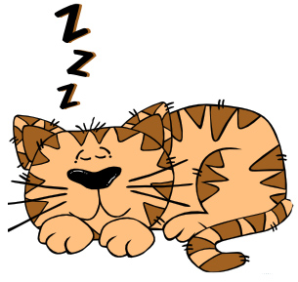
I can slither like a snake
Run like a hare
Dive like a dolphin
And hug like a bear
I can curl up like a cat
And dig like a dog
I am wonderfully made
Wonderfully made
And I thank You God

Slide 37
JUMP UP

Slide 38
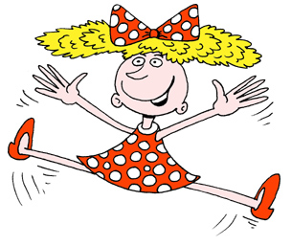
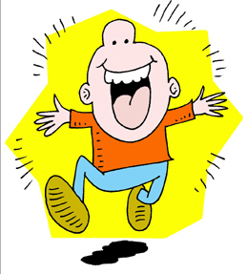
Jump up and wave your arms and shout hooray
God thinks you’re really great you’ve made His day

Slide 39

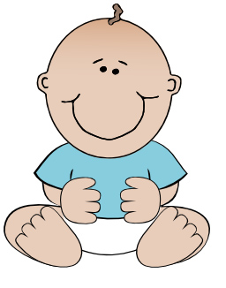

He loves me just the way I am
In fact He is my biggest fan
Jump up and wave your arms
And shout hooray

Slide 40
Jump up and wave your arms and shout hooray
God thinks you’re really great you’ve made His day

Slide 41
He loves me just the way I am
In fact He is my biggest fan
Jump up and wave your arms
And shout hooray

Slide 42
Jump up and wave your arms and shout hooray
God thinks you’re really great you’ve made His day

Slide 43
He loves me just the way I am
In fact He is my biggest fan
Jump up and wave your arms
And shout hooray

Slide 44
We’re jumping, jumping, jumping for Jesus
We’re jumping, jumping, jumping for joy
We’re jumping, jumping, jumping for Jesus
We’re jumping, jumping, jumping for joy

Slide 45
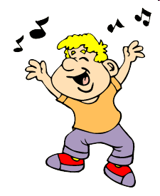
We’re shouting, shouting, shouting for Jesus
We’re shouting, shouting, shouting for joy
We’re shouting, shouting, shouting for Jesus
We’re shouting, shouting, shouting for joy

Slide 46
Jump up and wave your arms and shout hooray
God thinks you’re really great you’ve made His day

Slide 47
He loves me just the way I am
In fact He is my biggest fan
Jump up and wave your arms
And shout hooray

Slide 48
I’M YOURS

Slide 49
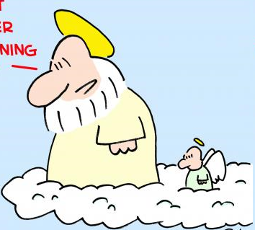
I’m Yours, You’re mine
I’m so excited Lord
‘Cos I know that you’re here
All of the time

Slide 50





If I go to the moon, or under the sea
If I climb the highest mountain
You’re still there with me
That’s the best thing about Your Love
You give me more and more and
More and more just because…

Slide 51
I’m Yours, You’re mine
I’m so excited Lord
‘Cos I know that you’re here
All of the time

Slide 52




Whether I am good or the biggest pain on earth
You never change Your mind,
I was Yours before my birth
That’s the best thing about Your love
You give me more and more and
More and more just because…

Slide 53
I’m Yours, You’re mine
I’m so excited Lord
‘Cos I know that you’re here
All of the time

Slide 54
SHINE!

Slide 55

Shine! from the inside out
That the world will see
You live in me (x2)

Slide 56

You know me
And you love me
You fill me
So send me…
…to Shine!

Slide 57
Shine! from the inside out
That the world will see
You live in me (x2)

Slide 58
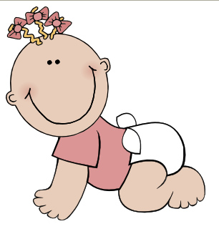
Know me, love me, fill me, send me (x3) to Shine!

Slide 59
AS I SIT QUIETLY

Slide 60
WHO’S THE KING
OF THE JUNGLE

Slide 61
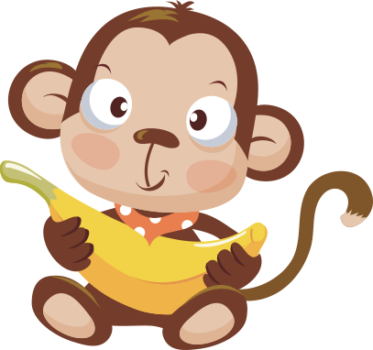


Who’s the king of the jungle? OO OO
Who’s the king of the sea?
Bubble, bubble bubble
Who’s the king of the universe
And who’s the king of me?

Slide 62



I tell you
J-E-S-U-S is
He’s the king of me
He’s the king of the universe
The jungle and the sea

